Slide 1



Slide 2
Computer Science & Engineering
Submitted to-
Anubhav Saxena
Ass. Professor
SCIT
Submitted by-
Deepesh Sherwal
15CS015
Tweet Classifier: Fake or Genuine

Slide 3
Contents
Welcome Screen
Contents
Data Science(Domain of training)
What and why is Data Science
What is Machine Learning
Training Project
Project Environment
What is Twitter
What analytics possible on twitter
Different features used in Model
Dataset Sample
Result
Thank you & query

Slide 4

Image source - Datacamp.com

Slide 5
What is Data Science?
Data science is an interdisciplinary field that uses scientific methods, processes, algorithms and systems to extract knowledge and insights from data in various forms, both structured and unstructured similar to data mining.
Data science is a "concept to unify statistics, data analysis, machine learning and their related methods" in order to "understand and analyze actual phenomena" with data. It employs techniques and theories drawn from many fields within the context of mathematics, statistics, information science, and computer science.
Source- https://en.wikipedia.org/wiki/Data_science

Slide 6
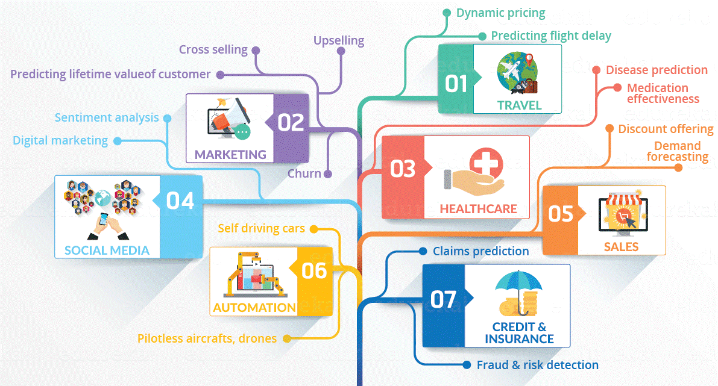
Image source - Edureka.co

Slide 7
What is Machine Learning?
Machine learning is a field of computer science that uses statistical techniques to give computer systems the ability to "learn" (e.g., progressively improve performance on a specific task) with data, without being explicitly programmed.
The name machine learning was coined in 1959 by Arthur Samuel.
Source- https://en.wikipedia.org/wiki/Machine_learning

Slide 8
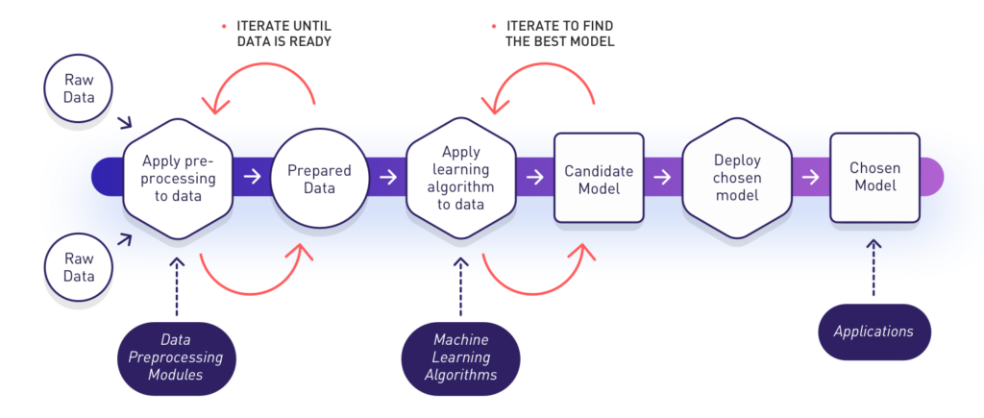
Image Source- https://www.datasciencecentral.com/profiles/blogs/soccer-and-machine-learning-2-hot-topics-for-2018

Slide 9
Project- Tweet Classifier: Fake or Genuine
In August of 2014, Twitter revealed that 8.5% of its monthly active users which equals approximately 23 million users have automatically contacted their servers for regular updates. Thus, detecting and filtering spammers from legitimate users are mandatory in order to provide a spam-free environment in Twitter.
In this project, develop a machine learning model to detect the tweets either it is fake or genuine.

Slide 10
Platform & libraries used for Project
Anaconda- Spyder
Tweepy- Retrieve data from Twitter
Pandas- Dataframe and preprocessing
Beautiful Soup- Fetch data from different websites
Urllib2- Provide connection to a website
Sci-Kit Learn- Machine Learning Algorithms

Slide 11
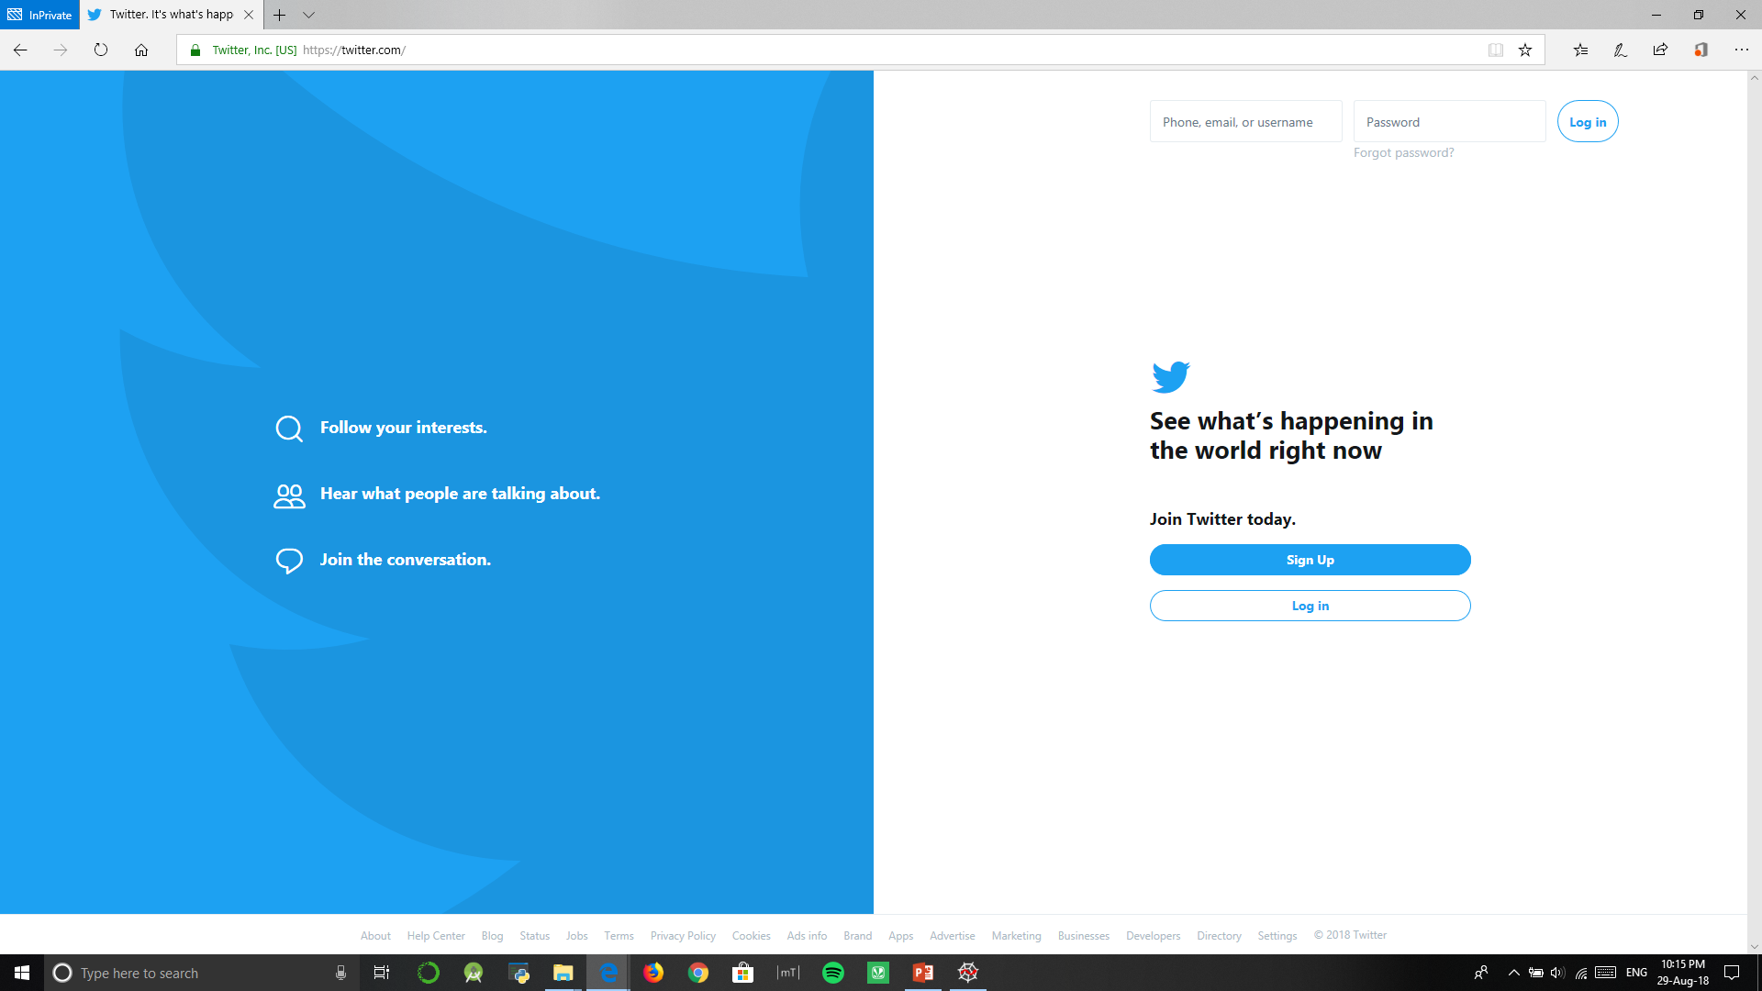
Twitter ??

Slide 12
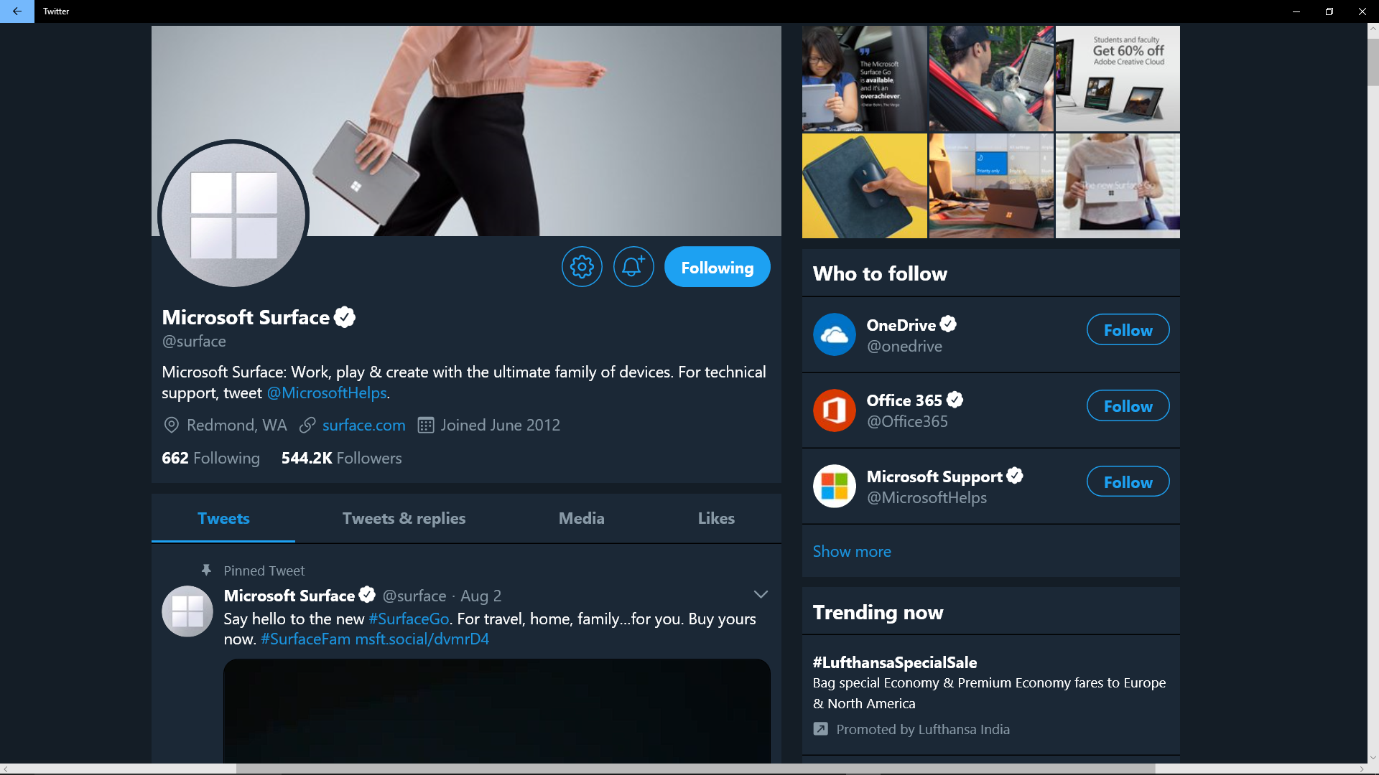

Slide 13
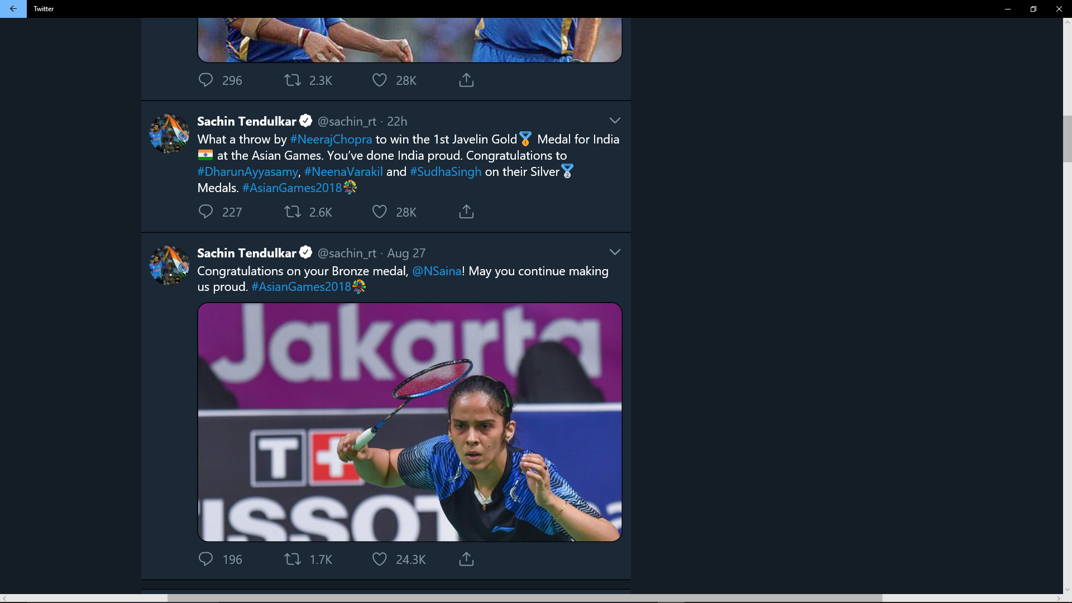

Slide 14
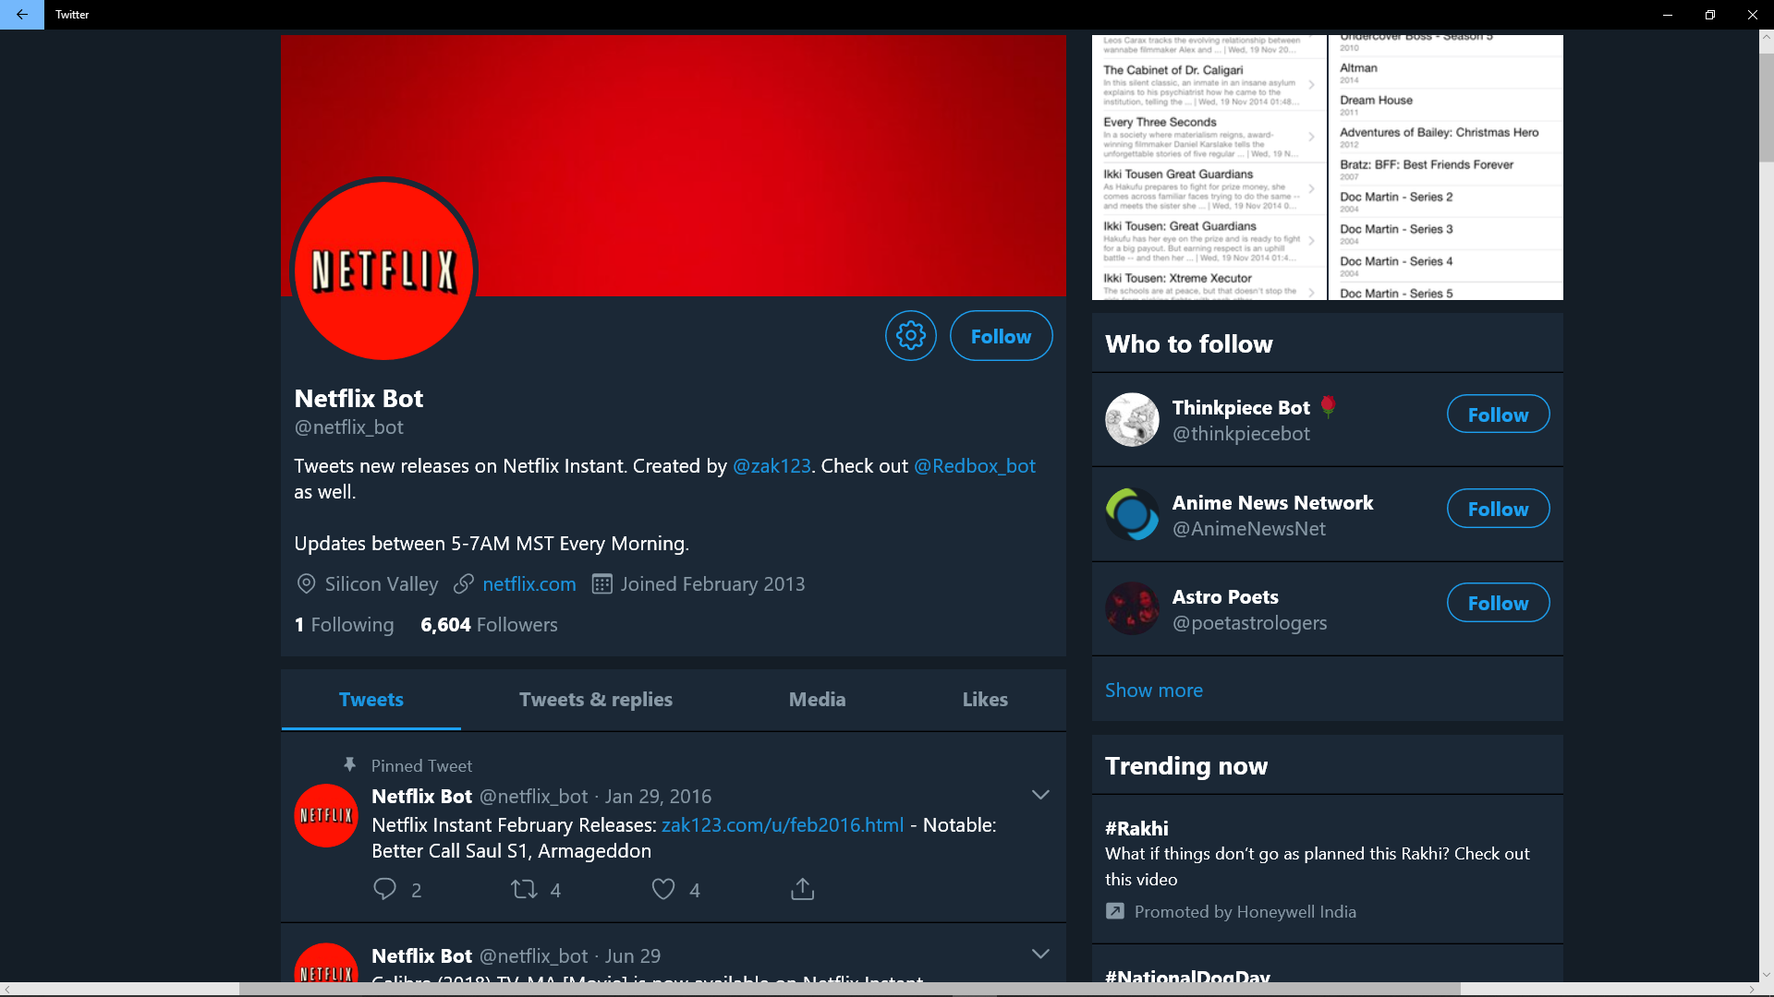

Slide 15
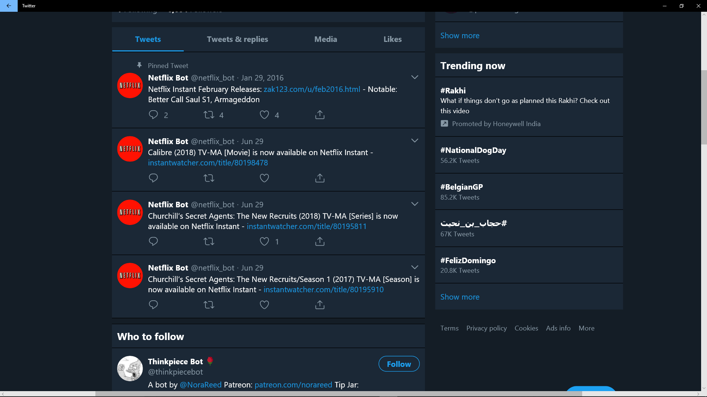

Slide 16
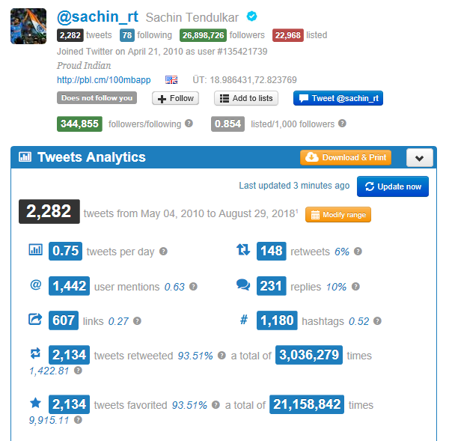

Slide 17
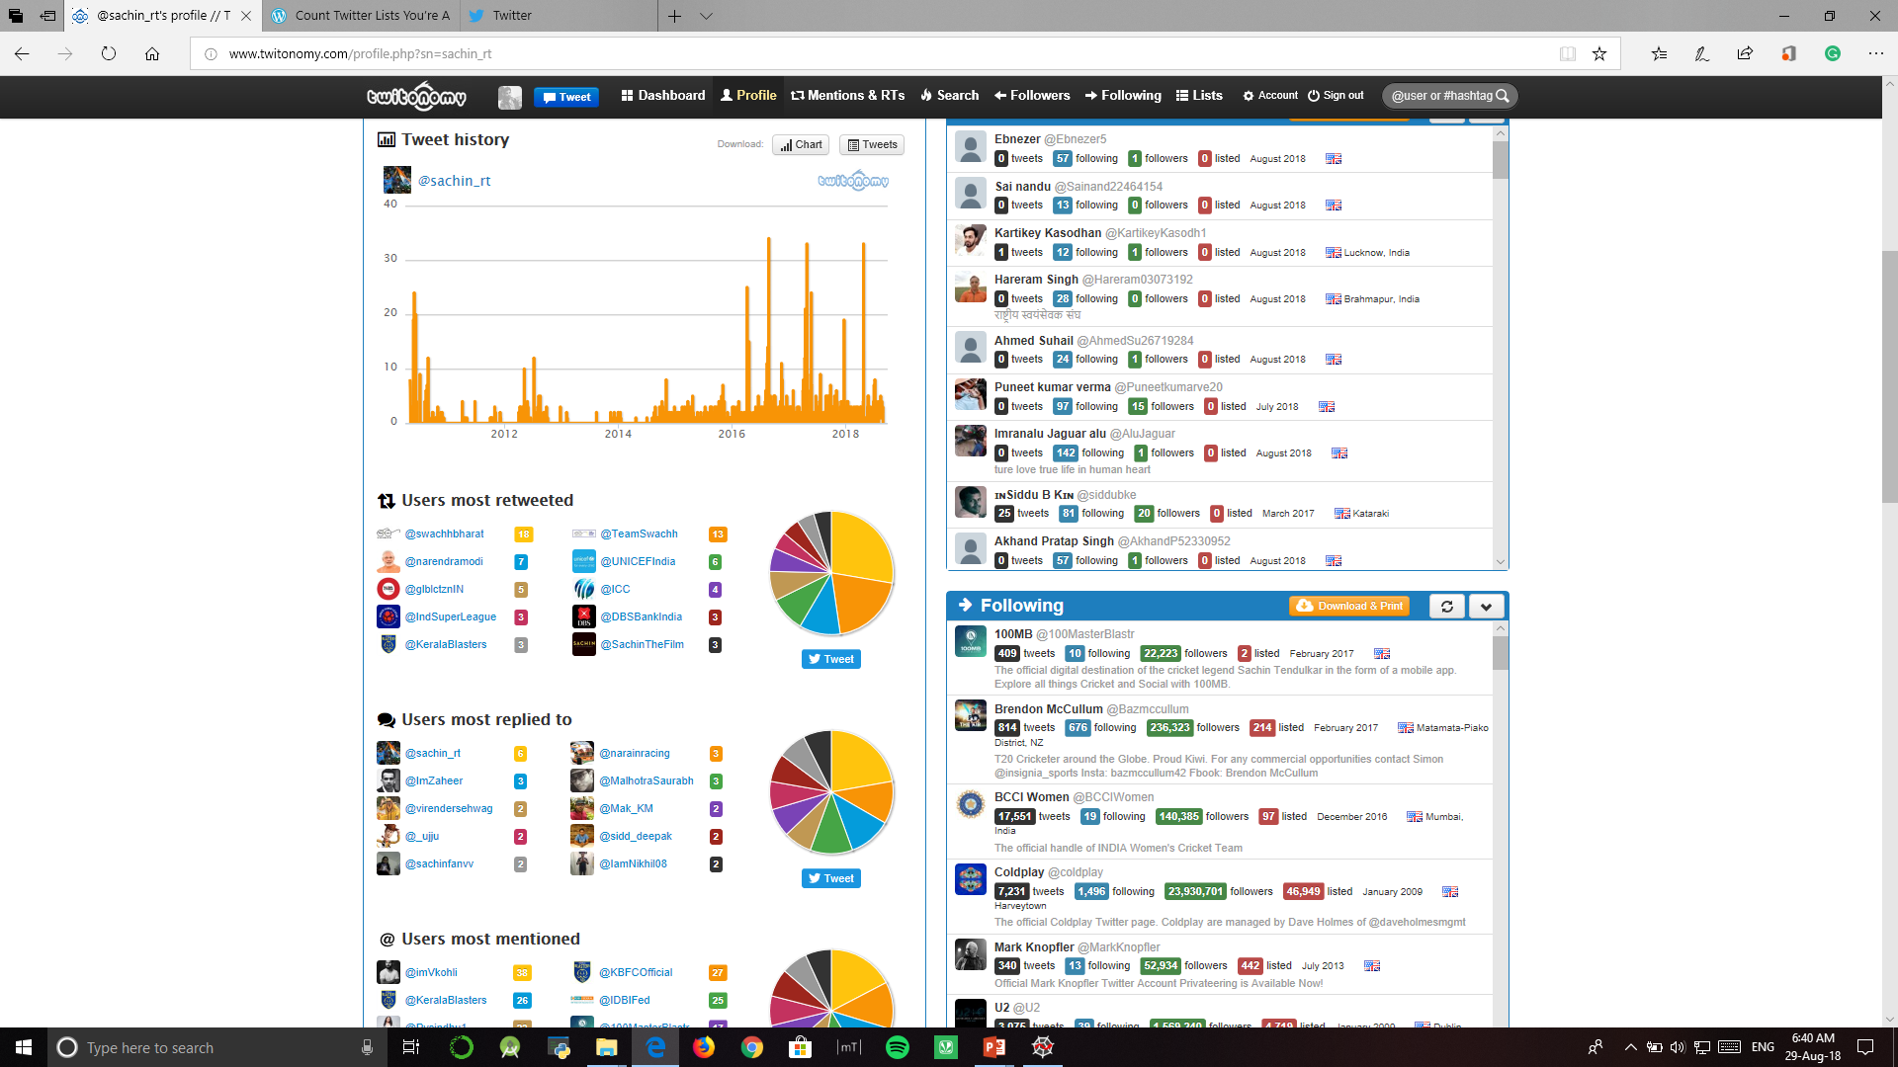

Slide 18
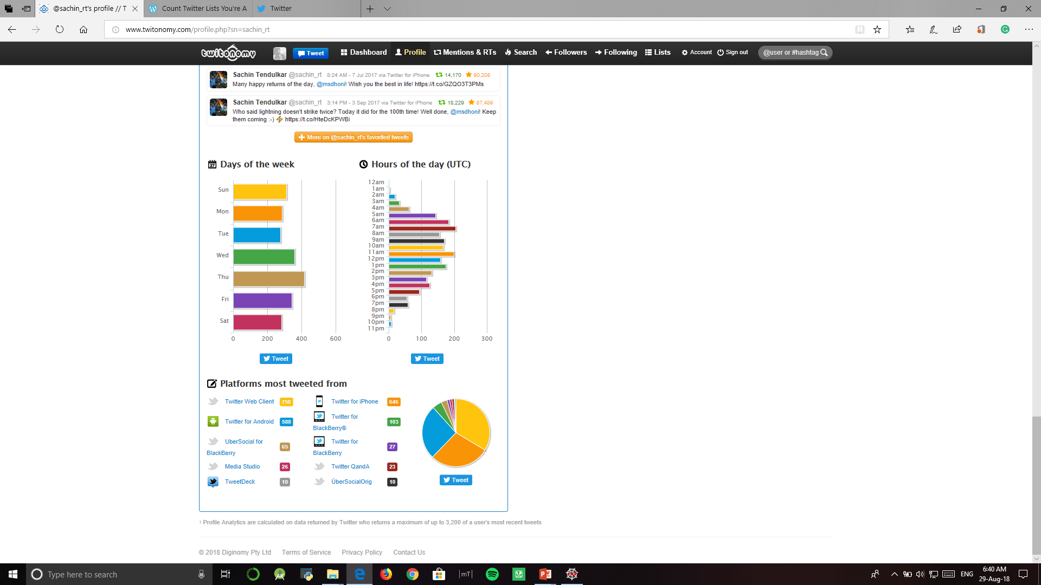

Slide 19
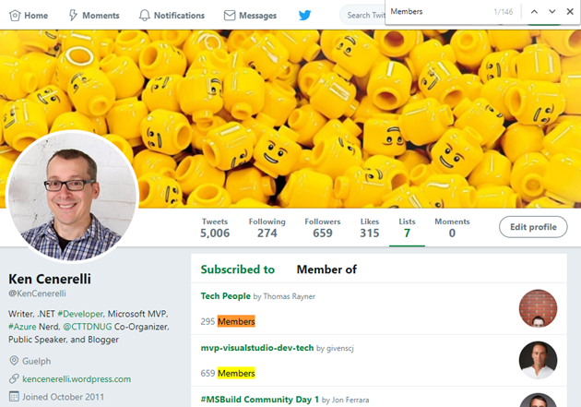
List Count
List count is different from followers or following, the more lists you are on, the more popular you probably are.
Image Source- https://kencenerelli.wordpress.com/2018/01/07/count-twitter-lists-youre-a-member-of/

Slide 20
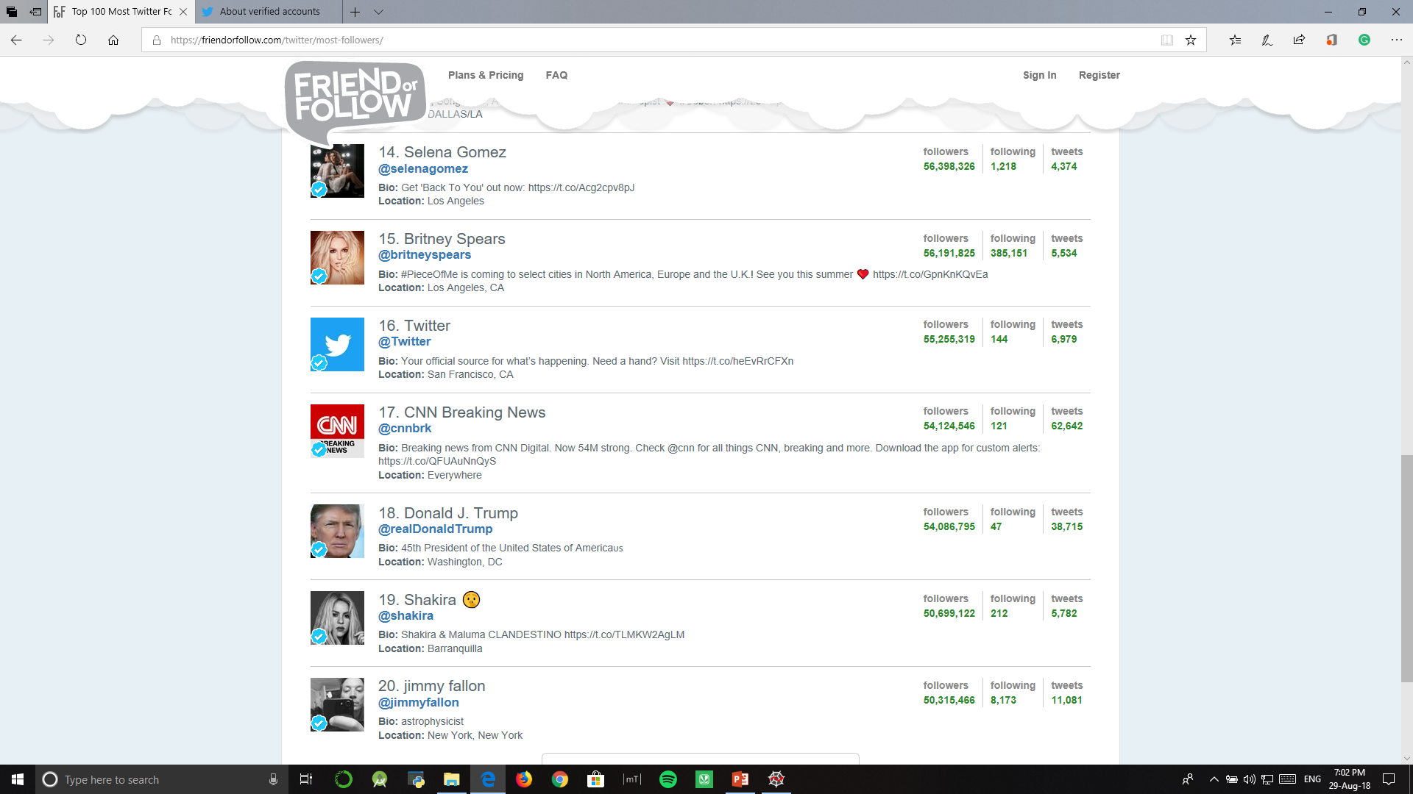
Account Authentication
The blue verified badge on Twitter lets people know that an account of public interest is authentic.
Image Source- https://blog.tickyes.com/has-twitter-sold-out-free-speech/

Slide 21
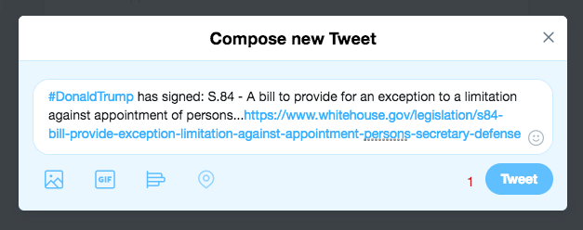
URLs Count
No of URLs used by a twitter account in a specific time or whole twitter life.

Slide 22
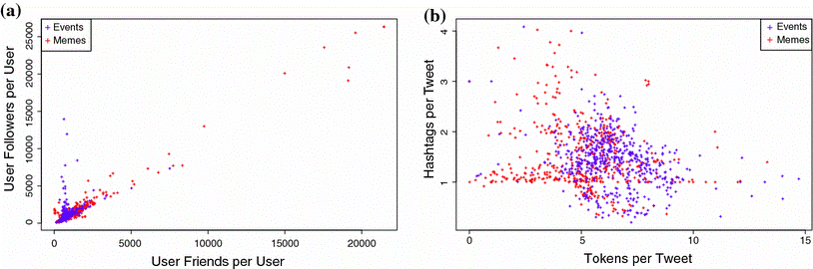
Hashtag and user tag Diversity
Unique Hashtags and user mentions used by a twitter account in a month

Slide 23

Likes & Retweet count
Total no of likes and retweet on tweets of a twitter user
Image Source- https://www.oxfordmediafactory.co.uk/2017/10/metrics-to-measure-twitter-success/

Slide 24
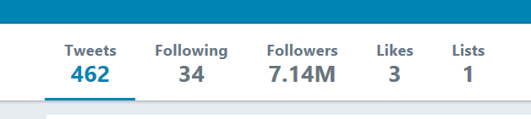
Friends Following Ratio
FF Ratio = Followers count/(Followers count + Following count)

Slide 25
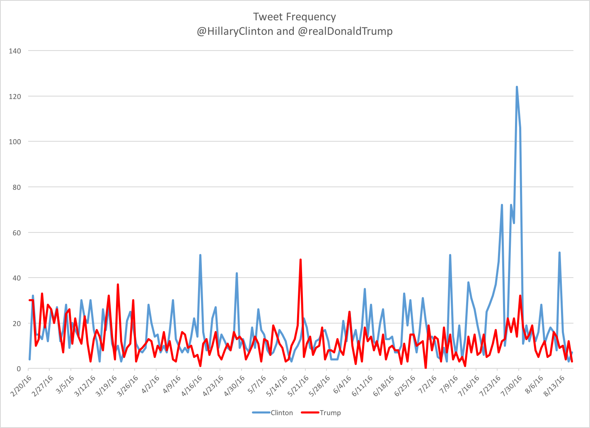
Tweet Frequency and Age of account
Image Source- https://medium.com/soapbox-dc/trumps-in-a-twitter-funk-9e8454c53e10

Slide 26
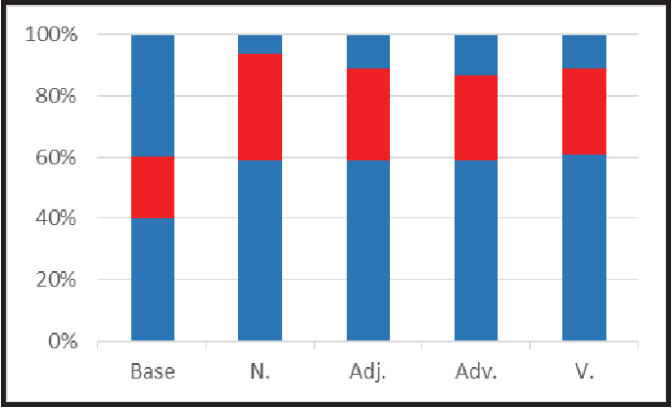
Lexicon Diversity
Unique new words used in tweets tweeting by a user in a month interval
Image Source- https://www.semanticscholar.org/paper/Combining-user-based-and-global-lexicon-features-in-Jin-Yang/f99ff05212dc01d66c5d84b43189436c8d3c4674

Slide 27
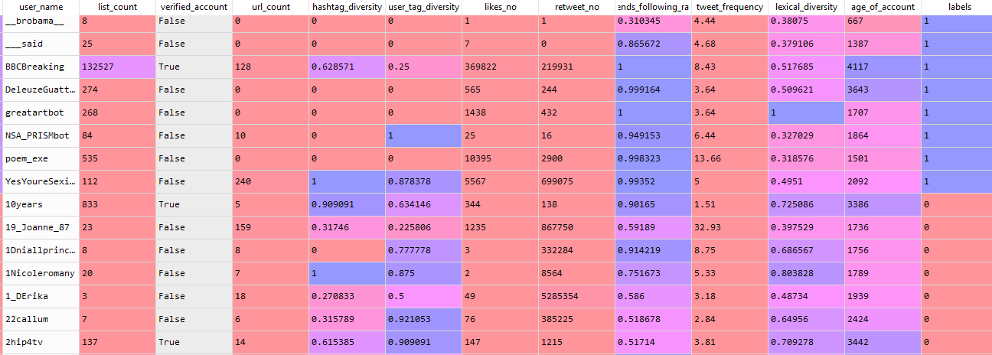
Dataset

Slide 28
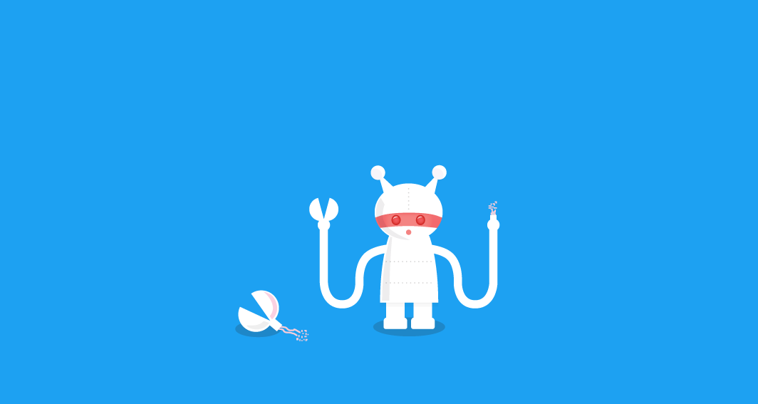
Result
From training the model we can conclude either Tweet is generated by Human or Bot than we can identify the
tweet is fake or genuine

Slide 29
Thank you
Queries

